Slide 1
Physics 101: Mechanics
Physics Department

Slide 2
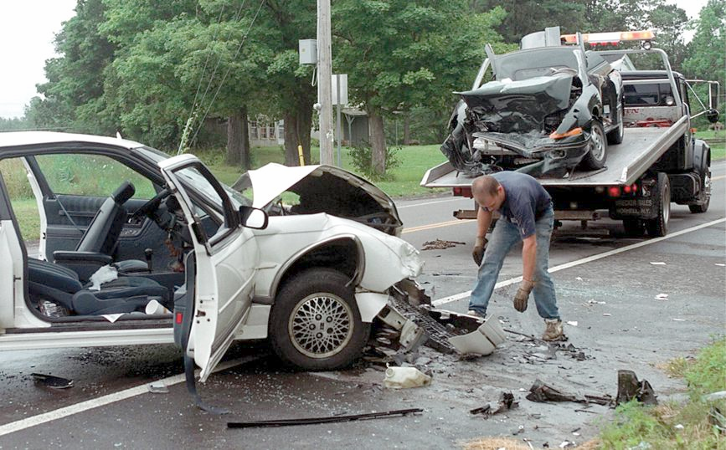
Linear Momentum and Collisions
Conservation
of Energy
Momentum
Impulse
Conservation
of Momentum
1-D Collisions
2-D Collisions
The Center of Mass

Slide 3
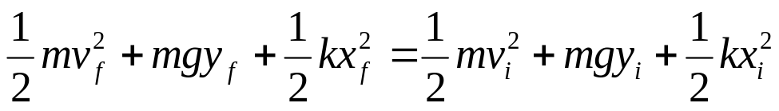
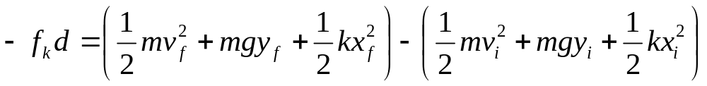
Conservation of Energy
Δ E = Δ K + Δ U = 0 if conservative forces are the only forces that do work on the system.
The total amount of energy in the system is constant.
Δ E = Δ K + Δ U = -f_{k}d if friction forces are doing work on the system.
The total amount of energy in the system is still constant, but the change in mechanical energy goes into “internal energy” or heat.

Slide 4
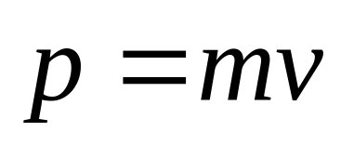
Linear Momentum
This is a new fundamental quantity, like force, energy. It is a vector quantity (points in same direction as velocity).
The linear momentum p of an object of mass m moving with a velocity v is defined to be the product of the mass and velocity:
The terms momentum and linear momentum will be used interchangeably in the text
Momentum depend on an object’s mass and velocity

Slide 5
Momentum and Energy
Two objects with masses m₁ and m₂ have equal kinetic energy. How do the magnitudes of their momenta compare?
(A) p₁ < p₂
(B) p₁ = p₂
(C) p₁ > p₂
(D) Not enough information is given
Notes:
E is correct.
1-kg object moving at 2 m/s
4-kg at 1 m/s
The two clearly do not have the same momenta.

Slide 6
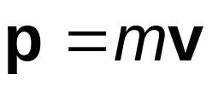
Linear Momentum, cont’d
Linear momentum is a vector quantity
  Its direction is the same as the direction of the velocity
The dimensions of momentum are ML/T
The SI units of momentum are kg m / s
Momentum can be expressed in component form:
  p_{x} = mv_{x} p_{y} = mv_{y} p_{z} = mv_{z}

Slide 7
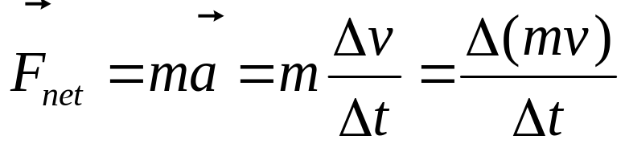
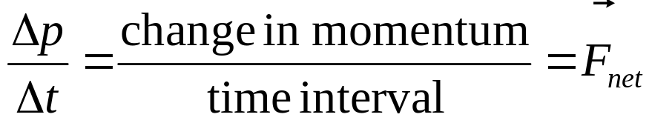
Newton’s Law and Momentum
Newton’s Second Law can be used to relate the momentum of an object to the resultant force acting on it
The change in an object’s momentum divided by the elapsed time equals the constant net force acting on the object

Slide 8
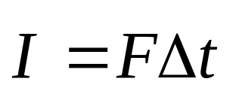

Impulse
When a single, constant force acts on the object, there is an impulse delivered to the object
  is defined as the impulse
  The equality is true even if the force is not constant
  Vector quantity, the direction is the same as the direction of the force

Slide 9
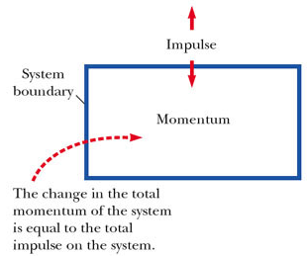
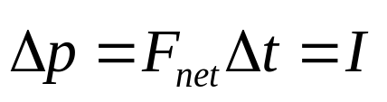
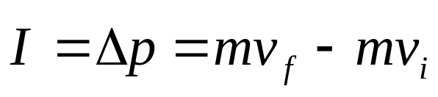
Impulse-Momentum Theorem
The theorem states that the impulse acting on a system is equal to the change in momentum of the system

Slide 10
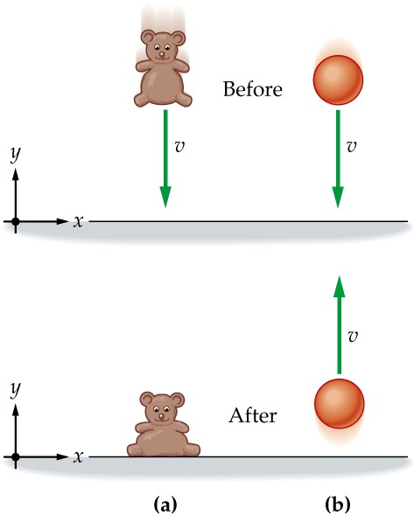
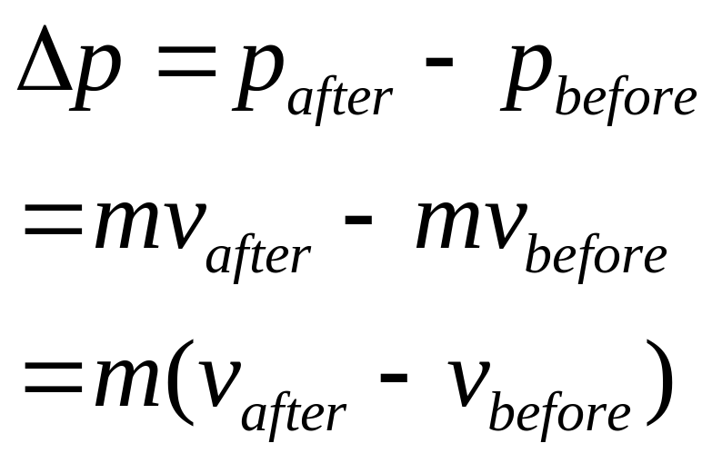
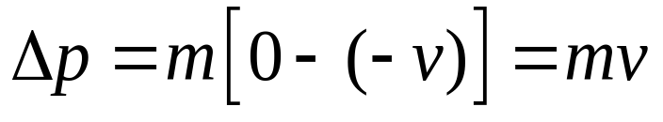
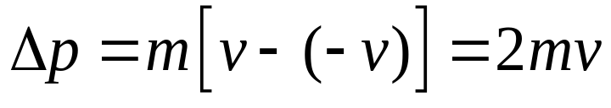
Calculating the Change of Momentum
For the teddy bear
For the bouncing ball

Slide 11
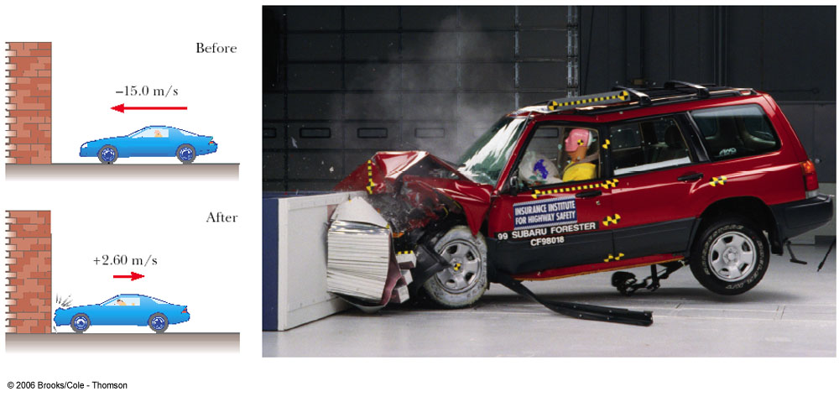
How Good Are the Bumpers?
In a crash test, a car of mass 1.5x10³ kg collides with a wall and rebounds as in figure. The initial and final velocities of the car are v_{i}=-15 m/s and v_{f} = 2.6 m/s, respectively. If the collision lasts for 0.15 s, find
(a) the impulse delivered to the car due to the collision
(b) the size and direction of the average force exerted on the car

Slide 12
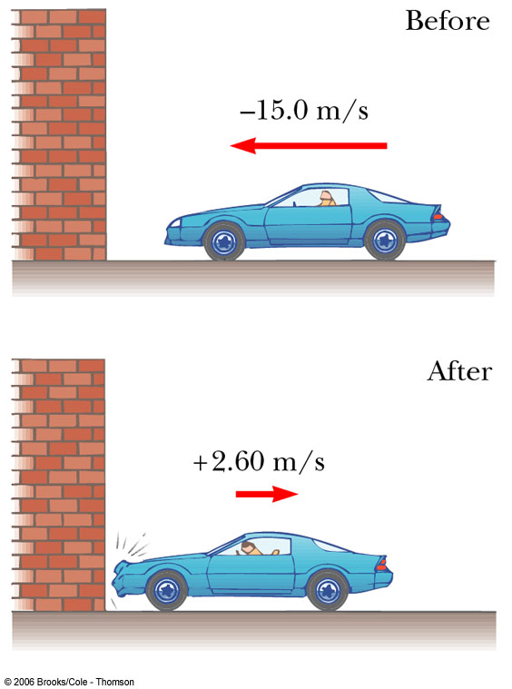

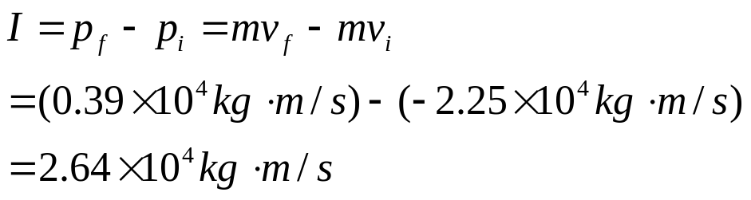
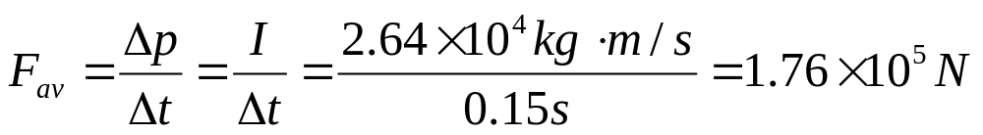
How Good Are the Bumpers?
In a crash test, a car of mass 1.5x10³ kg collides with a wall and rebounds as in figure. The initial and final velocities of the car are v_{i}=-15 m/s and v_{f} = 2.6 m/s, respectively. If the collision lasts for 0.15 s, find
(a) the impulse delivered to the car due to the collision
(b) the size and direction of the average force exerted on the car

Slide 13
Impulse-Momentum Theorem
A child bounces a 100 g superball on the sidewalk. The velocity of the superball changes from 10 m/s downward to 10 m/s upward. If the contact time with the sidewalk is 0.1s, what is the magnitude of the impulse imparted to the superball?
(A) 0
(B) 2 kg-m/s
(C) 20 kg-m/s
(D) 200 kg-m/s
(E) 2000 kg-m/s
Notes:
B

Slide 14
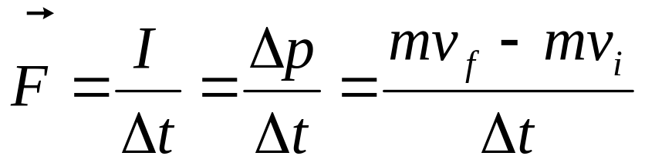
Impulse-Momentum Theorem 2
A child bounces a 100 g superball on the sidewalk. The velocity of the superball changes from 10 m/s downward to 10 m/s upward. If the contact time with the sidewalk is 0.1s, what is the magnitude of the force between the sidewalk and the superball?
(A) 0
(B) 2 N
(C) 20 N
(D) 200 N
(E) 2000 N
Notes:
B

Slide 15
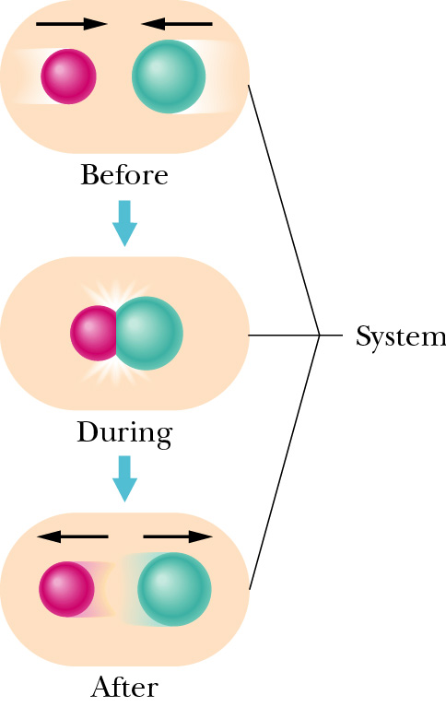
Conservation of Momentum
In an isolated and closed system, the total momentum of the system remains constant in time.
  Isolated system: no external forces
  Closed system: no mass enters or leaves
  The linear momentum of each colliding body may change
  The total momentum P of the system cannot change.

Slide 16
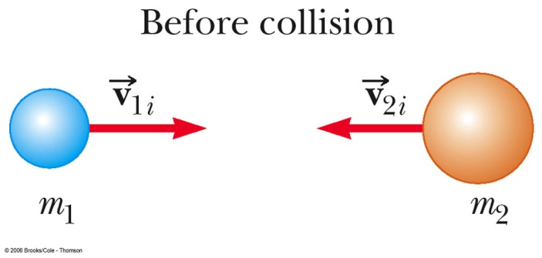
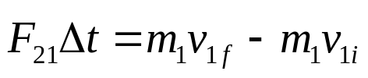

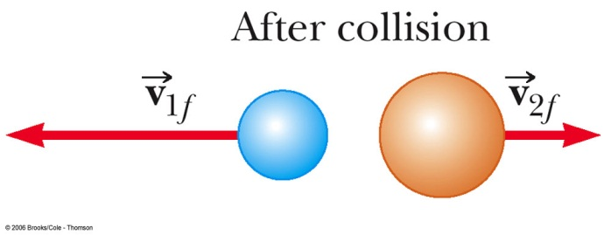

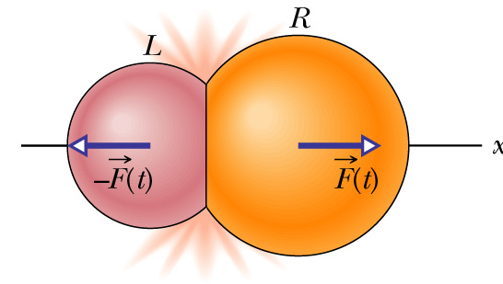

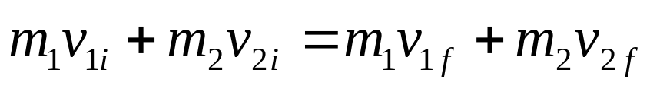
Conservation of Momentum
Start from impulse-momentum theorem
Since
Then
So

Slide 17
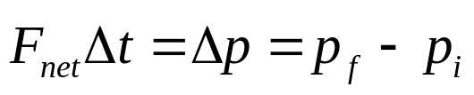
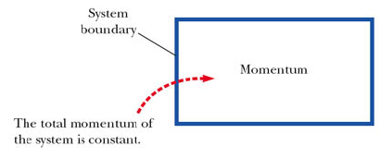
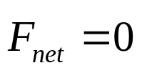

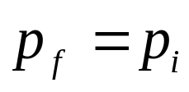
Conservation of Momentum
When no external forces act on a system consisting of two objects that collide with each other, the total momentum of the system remains constant in time
When then
For an isolated system
Specifically, the total momentum before the collision will equal the total momentum after the collision

Slide 18
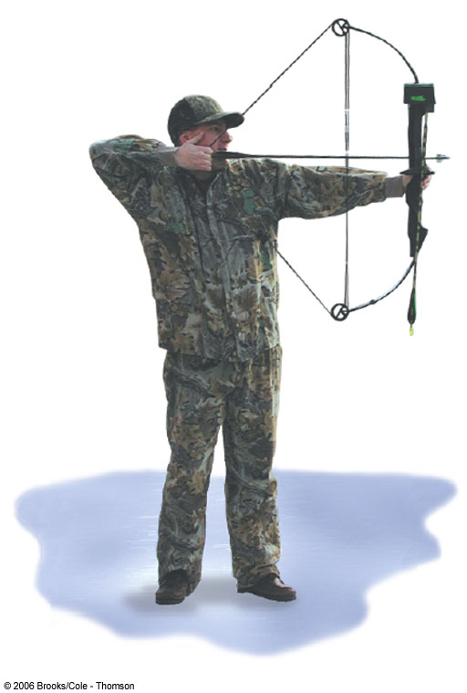
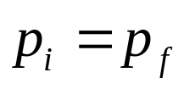

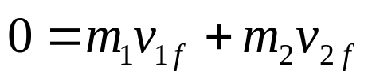
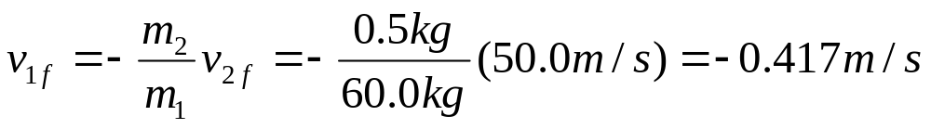
The Archer
An archer stands at rest on frictionless ice and fires a 0.5-kg arrow horizontally at 50.0 m/s. The combined mass of the archer and bow is 60.0 kg. With what velocity does the archer move across the ice after firing the arrow?

Slide 19
Conservation of Momentum
A 100 kg man and 50 kg woman on ice skates stand facing each other. If the woman pushes the man backwards so that his final speed is 1 m/s, at what speed does she recoil?
(A) 0
(B) 0.5 m/s
(C) 1 m/s
(D) 1.414 m/s
(E) 2 m/s
Notes:
E is correct.

Slide 20
Types of Collisions
Momentum is conserved in any collision
Inelastic collisions: rubber ball and hard ball
  Kinetic energy is not conserved
  Perfectly inelastic collisions occur when the objects stick together
Elastic collisions: billiard ball
  both momentum and kinetic energy are conserved
Actual collisions
  Most collisions fall between elastic and perfectly inelastic collisions

Slide 21
Collisions Summary
In an elastic collision, both momentum and kinetic energy are conserved
In a non-perfect inelastic collision, momentum is conserved but kinetic energy is not. Moreover, the objects do not stick together
In a perfectly inelastic collision, momentum is conserved, kinetic energy is not, and the two objects stick together after the collision, so their final velocities are the same
Elastic and perfectly inelastic collisions are limiting cases, most actual collisions fall in between these two types
Momentum is conserved in all collisions

Slide 22
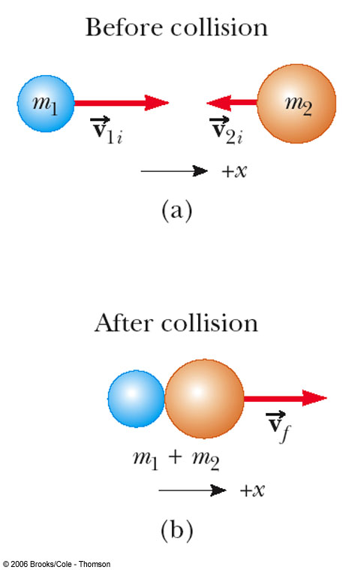
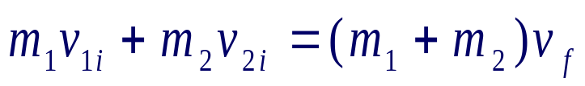
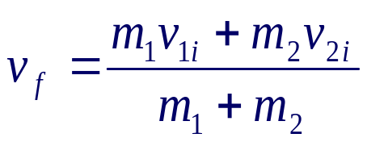
More about Perfectly Inelastic Collisions
When two objects stick together after the collision, they have undergone a perfectly inelastic collision
Conservation of momentum
Kinetic energy is NOT conserved

Slide 23
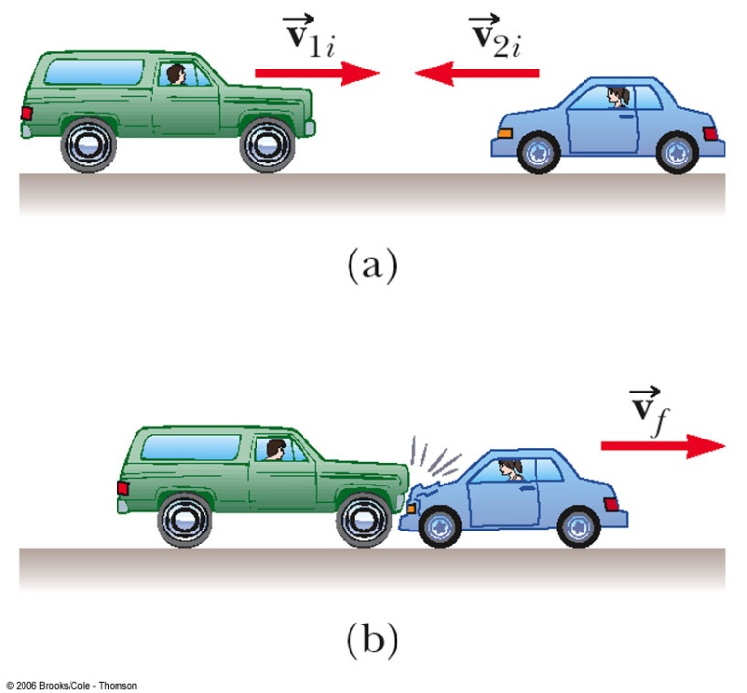
An SUV Versus a Compact
An SUV with mass 1.80x10³ kg is travelling eastbound at +15.0 m/s, while a compact car with mass 9.00x10² kg is travelling westbound at -15.0 m/s. The cars collide head-on, becoming entangled.
Find the speed of the entangled cars after the collision.
Find the change in the velocity of each car.
Find the change in the kinetic energy of the system consisting of both cars.

Slide 24
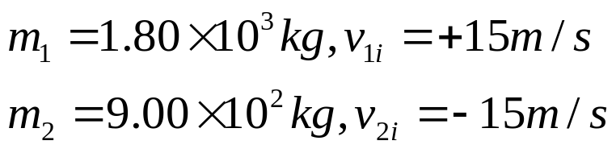
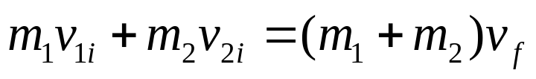
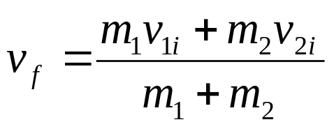

An SUV Versus a Compact
Find the speed of the entangled cars after the collision.

Slide 25
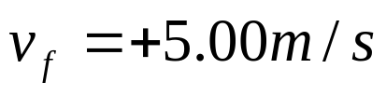
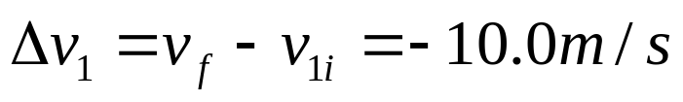
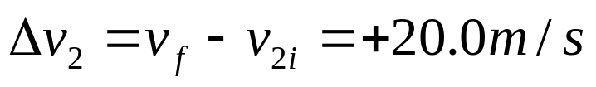
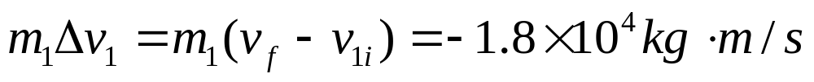

An SUV Versus a Compact
Find the change in the velocity of each car.

Slide 26
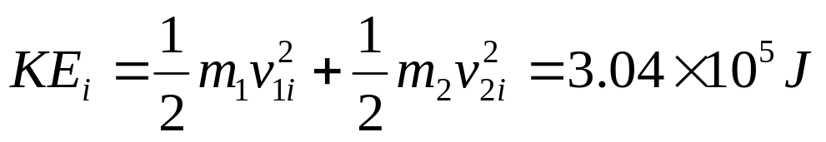
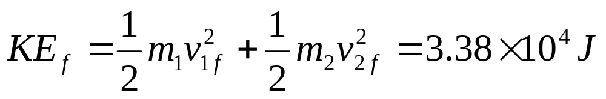
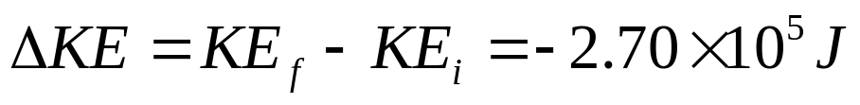
An SUV Versus a Compact
Find the change in the kinetic energy of the system consisting of both cars.

Slide 27
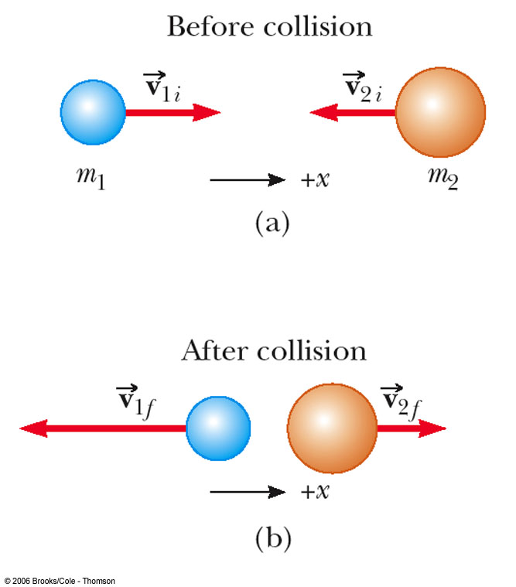
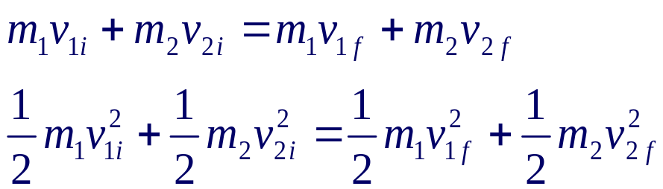
More About Elastic Collisions
Both momentum and kinetic energy are conserved
Typically have two unknowns
Momentum is a vector quantity
  Direction is important
  Be sure to have the correct signs
Solve the equations simultaneously

Slide 28






Elastic Collisions
A simpler equation can be used in place of the KE equation

Slide 29
Summary of Types of Collisions
In an elastic collision, both momentum and kinetic energy are conserved
In an inelastic collision, momentum is conserved but kinetic energy is not
In a perfectly inelastic collision, momentum is conserved, kinetic energy is not, and the two objects stick together after the collision, so their final velocities are the same

Slide 30

Conservation of Momentum
An object of mass m moves to the right with a speed v. It collides head-on with an object of mass 3m moving with speed v/3 in the opposite direction. If the two objects stick together, what is the speed of the combined object, of mass 4m, after the collision?
(A) 0
(B) v/2
(C) v
(D) 2v
(E) 4v
Notes:
A is correct.

Slide 31
Problem Solving for 1D Collisions, 1
Coordinates: Set up a coordinate axis and define the velocities with respect to this axis
  It is convenient to make your axis coincide with one of the initial velocities
Diagram: In your sketch, draw all the velocity vectors and label the velocities and the masses

Slide 32
Problem Solving for 1D Collisions, 2
Conservation of Momentum: Write a general expression for the total momentum of the system before and after the collision
  Equate the two total momentum expressions
  Fill in the known values

Slide 33
Problem Solving for 1D Collisions, 3
Conservation of Energy: If the collision is elastic, write a second equation for conservation of KE, or the alternative equation
  This only applies to perfectly elastic collisions
Solve: the resulting equations simultaneously

Slide 34

One-Dimension vs Two-Dimension

Slide 35


Two-Dimensional Collisions
For a general collision of two objects in two-dimensional space, the conservation of momentum principle implies that the total momentum of the system in each direction is conserved

Slide 36

Two-Dimensional Collisions
The momentum is conserved in all directions
Use subscripts for
  Identifying the object
  Indicating initial or final values
  The velocity components
If the collision is elastic, use conservation of kinetic energy as a second equation
  Remember, the simpler equation can only be used for one-dimensional situations

Slide 37


Glancing Collisions
The “after” velocities have x and y components
Momentum is conserved in the x direction and in the y direction
Apply conservation of momentum separately to each direction

Slide 38


2-D Collision, example
Particle 1 is moving at velocity and particle 2 is at rest
In the x-direction, the initial momentum is m₁v_{1i}
In the y-direction, the initial momentum is 0

Slide 39



2-D Collision, example cont
After the collision, the momentum in the x-direction is m₁v_{1f} cos θ + m₂v_{2f} cos φ
After the collision, the momentum in the y-direction is m₁v_{1f} sin θ + m₂v_{2f} sin φ
If the collision is elastic, apply the kinetic energy equation

Slide 40


Collision at an Intersection
A car with mass 1.5×10³ kg traveling east at a speed of 25 m/s collides at an intersection with a 2.5×10³ kg van traveling north at a speed of 20 m/s. Find the magnitude and direction of the velocity of the wreckage after the collision, assuming that the vehicles undergo a perfectly inelastic collision and assuming that friction between the vehicles and the road can be neglected.

Slide 41

Collision at an Intersection

Slide 42



Collision at an Intersection

Slide 43

The Center of Mass
How should we define the position of the moving body ?
What is y for U_{g} = mgy ?
Take the average position of mass. Call “Center of Mass” (COM or CM)

Slide 44
The Center of Mass
There is a special point in a system or object, called the center of mass, that moves as if all of the mass of the system is concentrated at that point
The CM of an object or a system is the point, where the object or the system can be balanced in the uniform gravitational field

Slide 45



The Center of Mass
The center of mass of any symmetric object lies on an axis of symmetry and on any plane of symmetry
  If the object has uniform density
The CM may reside inside the body, or outside the body

Slide 46



Where is the Center of Mass ?
The center of mass of particles
Two bodies in 1 dimension

Slide 47



Center of Mass for many particles in 3D?

Slide 48
Where is the Center of Mass ?
Assume m₁ = 1 kg, m₂ = 3 kg, and x₁ = 1 m, x₂ = 5 m, where is the center of mass of these two objects?
A) x_{CM} = 1 m
B) x_{CM} = 2 m
C) x_{CM} = 3 m
D) x_{CM} = 4 m
E) x_{CM} = 5 m
Notes:
D is correct.

Slide 49



Center of Mass for a System of Particles
Two bodies and one dimension
General case: n bodies and three dimension
  where M = m₁ + m₂ + m₃ +…

Slide 50



Sample Problem : Three particles of masses m1 = 1.2 kg, m2 = 2.5 kg, and m3 = 3.4 kg form an equilateral triangle of edge length a = 140 cm. Where is the center of mass of this system? (Hint: m1 is at (0,0), m2 is at (140 cm,0), and m3 is at (70 cm, 120 cm), as shown in the figure below.)

Slide 51
Motion of a System of Particles
Assume the total mass, M, of the system remains constant
We can describe the motion of the system in terms of the velocity and acceleration of the center of mass of the system
We can also describe the momentum of the system and Newton’s Second Law for the system

Slide 52


Velocity and Momentum of a System of Particles
The velocity of the center of mass of a system of particles is
The momentum can be expressed as
The total linear momentum of the system equals the total mass multiplied by the velocity of the center of mass

Slide 53


Acceleration and Force of the Center of Mass
The acceleration of the center of mass can be found by differentiating the velocity with respect to time
The acceleration can be related to a force
If we sum over all the internal forces, they cancel in pairs and the net force on the system is caused only by the external forces

Slide 54

Newton’s Second Law for a System of Particles
Since the only forces are external, the net external force equals the total mass of the system multiplied by the acceleration of the center of mass:

The center of mass of a system of particles of combined mass M moves like an equivalent particle of mass M would move under the influence of the net external force on the system

Slide 55



Slide 56


Slide 57


Slide 58



Slide 59



Slide 60


Slide 61


Slide 62


Slide 63


Slide 64


Slide 65


